Slide 1
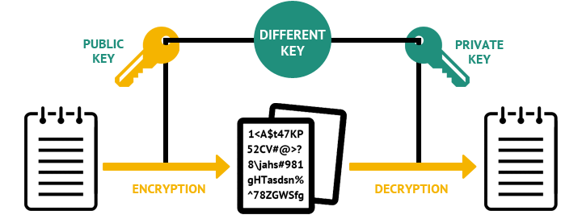
Asymmetric Cryptography
Notes:
https://www.digicert.com/ssl-cryptography.htm
https://www.wolframalpha.com/input/?i=79%5E(-1)+mod+3220&wal=header
Openssl
https://www.kinamo.be/en/support/faq/useful-openssl-commands
Math basics
https://www.mathsisfun.com/definitions/relatively-prime.html

Slide 2

Current Cryptographic Standards
Encryption
(Confidentiality)
Digital Signatures
(Authentication / Non Repudiation
Message Integrity)
Symmetric Cryptography
Asymmetric Cryptography
Hash Algorithm
MD2
MD5
SHA
SHA-1
SHA-2
SHA-3
Stream Cipher
RC4
A5/1
…..
Block Cipher
AES, DES, 3DES
Blowfish, Twofish, Serpent
…..
Discrete Log
Diffe-Helman
Elliptic Curve
ElGamal
…..
Factoring
RSA
….
2
Notes:
https://stackoverflow.com/questions/50053884/use-rsa-public-key-to-generate-private-key-in-openssl
Message Digest
Key Management
ISA/KMP
IKE
SKIP
Photuris
Diffe-Helman
ElGamal
Public Key Infrastructure (PKI)
PXIX
SPKI
SDS
PGP
DNSEC

Slide 3


Cryptography revisited
Two properties of symmetric (secret-key) crypto-systems:
The same secret key K is used for encryption and decryption
Encryption and Decryption are very similar (or even identical) functions
Alice
Bob
p
e_{K}(p)
d_{K}(c)
p
c
K
K

Slide 4
Symmetric Cryptography: Analogy
Safe with a strong lock, only Alice and Bob have a copy of the key
Alice encrypts → locks message in the safe with her key
Bob decrypts → uses his copy of the key to open the safe
Open and close using shared secret keys
Secret key agreement required !
K-open = K-close
Notes:
(mostly one shared key) !!

Slide 5
Symmetric Cryptography: Analogy
Alice
Bob
Shared Key = k Secret key agreement Shared Key = k
k
Message
Message
Lock
k
Unlock

Slide 6
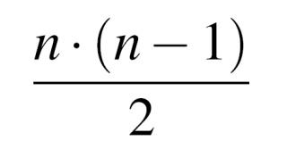
Symmetric Cryptography Shortcomings
Key distribution problem: The secret key must be exchanged securely
Establish a shared key with each entity we want to communicate with
Number of keys: In a network, each pair of users requires an individual key
→ n users in the network require keys, each user stores (n-1) keys
No support for message integrity: verifying that a message comes intact from the sender
No support for “non-repudiation“
Example: Alice can claim that she never ordered a TV on-line from Bob (he could have fabricated her order)
Notes:
Analogy for symmetric-key algorithms: Symmetric-key schemes are analogous to a safe box with a strong lock.
Everyone with the key can deposit messages in it and retrieve messages.
Symmetric algorithms, e.g., AES or 3DES, are very secure, fast & widespread but:
Alice or Bob can cheat each other, because they have identical keys.

Slide 7
Symmetric Cryptography Shortcomings
Question: How many secret-keys needed to be exchanged in order to set up a system of n-users?
1
4
1
n
5
.
2
2
.
.
3
3
10 key-exchanges for 5 users
n (n-1) keys for n users
2
For 10 000 users we need 50 million key-exchanges !
Public-Key system drops out the secret key-agreement completely

Slide 8

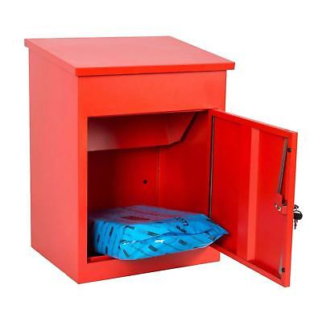
Idea behind Asymmetric Cryptography
New Idea:
Use the “good old mailbox“ principle:
Everyone can drop a letter
But: Only the owner has the
correct key 🔑 to open the box
Notes:
1976: first publication of such an algorithm by Whitfield Diffie and Martin Hellman,and also by Ralph Merkle.

Slide 9

Asymmetric Cryptography: Analogy
🔐
K-lock (public)
🔑
K-unlock (private)
- Lock and Unlock with different keys!!
- No Secret Key Agreement required
Notes:
Two Major Schemes in Public Key Cryptography:
Diffie-Hellman Public Key exchange scheme
RSA public Key secrecy system
Alice deposits (encrypts) a message with the - not secret - public key K_{pub}
Only Bob has the - secret - private key K_{pr} to retrieve (decrypt) the message

Slide 10
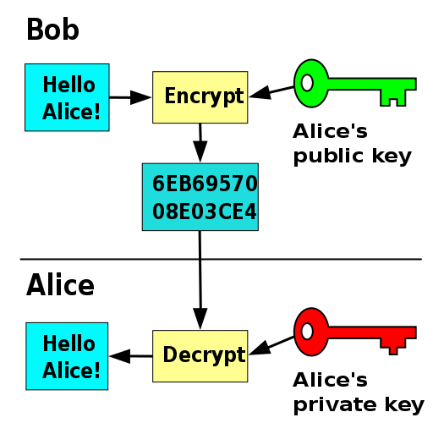
Asymmetric Cryptography
→ Key Exchange Problem solved
→ Anyone can encrypt messages using the public key, but only the holder of the paired private key can decrypt. Security depends on the secrecy of the private key.
→ During the key generation, a key pair K_{pub} and K_{pr} is computed
Notes:
Principle: “Split up” the key
Public Key (K_{pub}) (Encrypt)
Secret Key (K_{pr}) (Decrypt)

Slide 11
Public Key Cryptography Applications
The asymmetric cryptography (e.g., RSA) is mainly used for:
Key Exchange without a pre-shared secret (key)
Digital Signatures to provide message integrity and non-repudiation
Rarely used for:
Encryption because it is computationally very intensive (1000 times slower than symmetric Algorithms!)
Notes:
Diffie-Hellman key exchange,
, DSA or ECDSA
Identification, using challenge-response protocols with digital signatures
3 Categories:
➢ Encryption/decryption (provide secrecy)
➢ Digital signatures (provide authentication)
➢ Key exchange (of session keys)
It looks as though public-key schemes can provide all
functionality needed in modern security protocols such as
SSL/TLS. However, the major drawback in practice is that encryption of
data is extremely computationally demanding with public-key
algorithms. Many block and stream ciphers can encrypt 1000 times
faster in software than public-key algorithms. On the other hand,
symmetric algorithms are poor at providing digital signatures and key
establishment/transport functionality. Hence, most practical protocols
are hybrid protocols which incorporate both symmetric and public-key
algorithms.

Slide 12
Hybrid Crypto System
In practice, hybrid system is used incorporating both asymmetric and symmetric algorithms:
Key exchange and digital signatures are performed with (slow) asymmetric algorithms
Encryption of data is done using (fast) symmetric ciphers, e.g., block ciphers or stream ciphers
Notes:
(for symmetric schemes)

Slide 13
Hybrid Crypto System – Example
Alice
Bob
K_{pubB}
(K_{pubB},K_{prB})
Choose a random symmetric key K
Key Exchange
(asymmetric)
c₁ = e_{KpubB}(K)
c₁
K = d_{KprB}(c₁)
message m
Data Encryption
(symmetric)
c₂
c₂ = AES_{K} (m)
m = AES⁻¹_{K} (c₂)
AES used as the symmetric cipher
Notes:
Example: Hybrid protocol with AES as the symmetric cipher

Slide 14
Key Exchange with Public Key Crypto
Alice creates a secret key, encrypts it with Bob’s public key and sends it off
Bob decrypts the message with his private key
Use shared key for further communication
This is how many applications work
Could encrypt/decrypt using public key cryptography but it is slow
Notes:
1977: Rivest-Shamir-Adleman proposed the first PKE (Turing Award 2002)

Slide 15

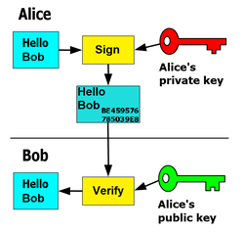
Digital Signatures
Alice signs a message with her private key
Bob can verify that Alice sent the message (i.e., non-repudiation) and that the message has not been modified (i.e., integrity)

Slide 16
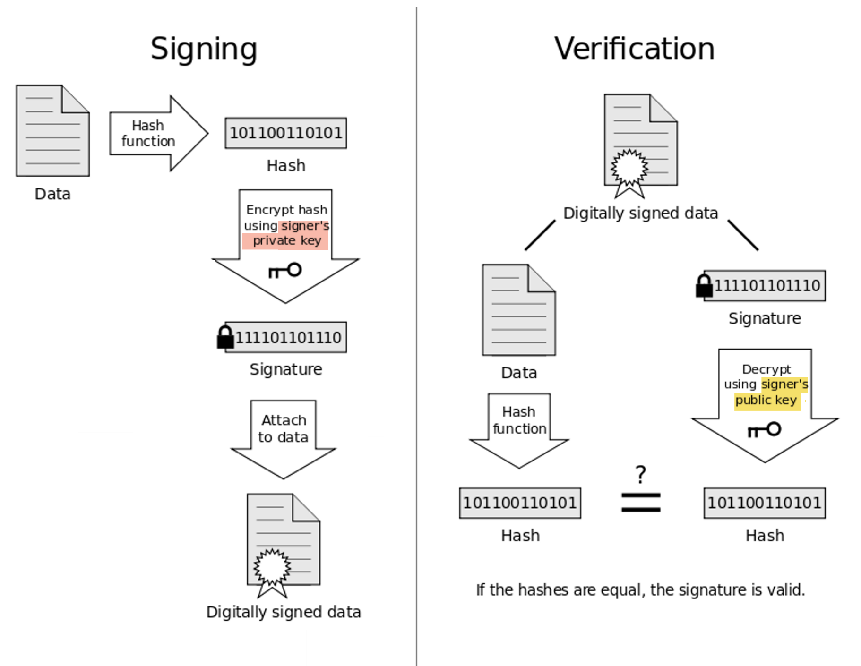
Public-Key Signature Process
Notes:
http://wiringdiagramshop.today/hash-function-diagram.html

Slide 17

RSA

Slide 18
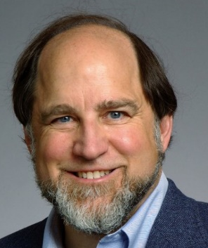
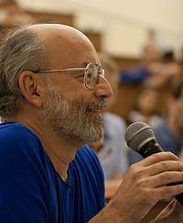
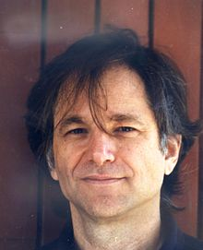
RSA Cryptosystem
Rivest Shamir Adleman
Developed by Rivest, Shamir, and Adleman in 1977
Until now, RSA is the most widely use asymmetric cryptosystem although Elliptic Curve cryptography (ECC) becomes increasingly popular
RSA is mainly used for two applications: Key exchange & Digital signatures
Notes:
Martin Hellman and Whitfield Diffie published their landmark public-key paper in 1976
Ronald Rivest, Adi Shamir and Leonard Adleman proposed the asymmetric RSA cryptosystem in1977

Slide 19
RSA One-way Function (Lock)
Asymmetric schemes are based on a “one-way function” f():
Computing y = f(x) is computationally easy
Computing the inverse x = f⁻¹(y) is computationally infeasible
One way functions are based on mathematically hard problems
RSA security relies on the difficulty of factoring large integers
Multiplying two primes is easy (e.g., 1889 x 3547 = 6,700,283 )
Given a composite integer n, find its prime factors is mathematically hard!
(e.g., It is hard to find Prime₁ and Prime₂ such that Prime₁ x Prime₂ = 6,700,283 )
Factorization
Problem (RSA Lock)
p
p
p.q
m
?
q
m
q
Notes:
RSA security relies on the difficulty of factoring large integers
In addition, there are many other public-key schemes, such as NTRU or
systems based on hidden field equations, which are not in wide spread
use. Often, their security is not very well understood.
Discrete Logarithm (Diffie-Hellman, Elgamal, …): Given a, y and m, find x such that a^{x} = y mod m (Exponentiation a^{x} : easy)
Elliptic Curves (EC): Generalization of discrete logarithm
Three main families:
Note: This problems are considered mathematically hard, but no proof exists (so far).

Slide 20
Encryption and Decryption
Encryption and decryption are simply exponentiations
In practice d and n are very long integer numbers (≥ 1024 bits)
The security of the scheme relies on the fact that it is hard to derive the private key d given the public-key (n, e)
Definition
Given the public key (n,e) = k_{pub} and the private key d = k_{pr} we write
c = e_{kpub}(m) = m^{e} mod n
m = d_{kpr}(c) = c^{d} mod n
e_{kpub}() is the encryption operation and d_{kpr}()is the decryption operation.
Notes:
Message m raise it to the power e
“private exponent”
The inverse of any number times its self is 1 =
1 2
-- x -- = 1
1
RSA operations are done over the integer ring Z_{n} (i.e., arithmetic modulo n), where n = p * q, with p, q being large primes
where x, y ε Z_{n.}

Slide 21
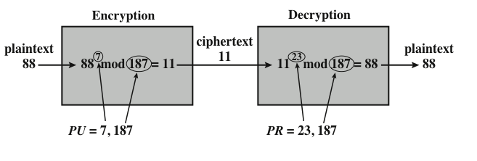
RSA Example
🔐
🔑

Slide 22
RSA Key Generation Algorithm
Output: public key: k_{pub} = (n, e) and private key k_{pr} = d
Choose two large primes p, q
Compute n = p * q
Compute Φ(n) = (p-1) * (q-1)
Select the odd public exponent e such that 1 < e < Φ(n) and
gcd(e, Φ(n) ) = 1 (i.e. e does not share any factor with Φ(n) )
Compute the private key d such that (d * e) mod Φ(n) = 1
=> Compute d by solving ex + φ(n)y = 1 using Extended Euclidean Algorithm
RETURN k_{pub} = (n, e), k_{pr} = d
🔐
🔑
d is the inverse of e mod Φ(n) => d = e⁻¹ mod Φ(n)
gcd(e, Φ(n)) = 1 ensures that e has an inverse (i.e., a private key d )
Φ is called Phi gcd is the greatest common divisor
Notes:
https://www.mathsisfun.com/definitions/relatively-prime.html
http://supplementalmemory.blogspot.com/2013/02/extended-euclidean-algorithm-pen-and.html?q=rsa
Very good explanation:
http://mathforum.org/library/drmath/view/51623.html
The inverse of 3 mod 24 is a number that when multiplied by 3 gives a result that is congruent to 1 mod 24 - that is, the product will be one more than a multiple of 24. However, no such number exists because 3 is not relatively prime to 24 (i.e., gcd(3,24) = 3 and this is greater than one).
RSA has set-up phase during which the private and public keys are computed
Challenge = Finding the modular inverse of e
d * e ≡ 1 mod Φ(n)
https://crypto.stackexchange.com/questions/5889/calculating-rsa-private-exponent-when-given-public-exponent-and-the-modulus-fact
http://mathonline.wikidot.com/additional-examples-of-finding-rsa-decryption-keys
Back Substitution Feedback
http://igotshittodo.blogspot.com/2016/05/back-substitution-feedback.html
https://www.mathsisfun.com/definitions/relatively-prime.html
When two numbers have no common factors other than 1. In other words there is no value that you could divide them both by exactly (without any remainder).
d=e−1(mod1560)
Example:
https://math.stackexchange.com/questions/2228743/what-do-you-do-if-the-decryption-key-d-is-equal-to-1
Like all asymmetric schemes,
d = inverse of e mod Φ(n)
Co-prime = do not share any factor other than 1
de = 1 mod F(n)
(1) Choose 2 prime numbers p and q
(2) Computer n = p x q = 2 x 7 = 14
(3) Φ(n) = (p-1) x (q-1)
Φ(n): count the co-primes do not have common factors with n
Coprimes = They share no common factor with 14
Φ(n) = 1 x 6 = 6
(4) Choose e (for encryption) has the following properties
1 < e < Φ(n)
Must be coprime with n and Φ(n)
e = 5 (obey these conditions)
(n, e) is the lock I can hand-out to every one.
(5) Choose d such that de (mod Φ(n)) = 1
5d (mod 6) = 1
5d are multiples of 5... list them and do mod 6 on them
1 5 5
2 10 4
3 15 3
4 20 2
5 25 1
6 30 0
(this pattern is going to repeat)
m
...
e * d mod Φ(n) = 1
Table: 2 columns and 2 rows.
First row we right Φ(n) for both cols
2nd Row we right e and 1
Divide Φ(n) by e: 40 / 7 = 5
We multiply this result by 7 and 1
We compute Φ(n) - result. We right the results below each of the column
40 40
7 1
7*5 1*5
35 5
5 35
We 3rd row we can remove the 1st row
7 1
5 35
5 35
2 -34 mod 40
2 6
Then we keep last 2 rows
5 35
2 6
4 12
1 23 => arrive to result
Choosing two large, distinct primes p, q (in Step 1) is non-trivial
gcd(e, Φ(n) ) = 1
Remarks:
gcd(e, Φ(n)) = 1 ensures that e has an inverse and, thus, that there is always a private key d
gcd = greatest common divisor
gcd(e, Φ(n) ) = 1

Slide 23
Example: RSA with small numbers
ALICE
Message m = 4
c= m^{e} = 4³ mod 33 = 31
BOB
Choose p = 3 and q = 11
Compute n = p * q = 33
Φ(n) = (3-1) * (11-1) = 20
Choose e = 3
Compute the private key d such that (d * e) mod Φ(n) = 1
=> d=7
c^{d} = 31⁷ mod 33 = 4
K_{pub} = (33,3)
c = 31
Notes:
Another good example http://pajhome.org.uk/crypt/rsa/rsa.html
Excellent http://ccom.uprrp.edu/~humberto/very-small-rsa-example.html
Calculator https://www.calculatorsoup.com/calculators/math/gcf.php
Example Back substitution http://igotshittodo.blogspot.com/2016/05/back-substitution-feedback.html
gcd is the lagest number that divides 3 and 20 evenly.
We can use Euclidian Algorithm to solve this:
We take the largest of the 2 numbers in this case 20. Which is equal to 3 times some number q + some reminder r
q is how many times 3 goes into 30. 3 goes 6 times into 20 with a reminder 2.
We take the number in the left position and we break it down in terms to the reminder... We left shift ... Follow this pattern all the way down.
Move 3 to where 20 was
Move 2 to where 3 was
=> Take larger of 2 numbers = small number x some number + reminder (2300 years old algorithm)
to find d another way easier than this d=1+(n*m)/e So that n start 0 to infinity number 0,1,2,3,4,5,6,7,8,9,10,11,12,13,..... The result of the previous equation =just int number but not double for example : 1+(3*40)/7=17.2 Do not take because 17.2 is double 1+(4*40)/7=161/7=23 then d=is 23 this is take because is int note: n in previous equation different from n=(p-1)*(q-1)

Slide 24
Example: RSA with small numbers
ALICE
Message m = 2
c= m^{e} = 2³ mod 15 = 8
BOB
Choose p = 3 and q = 5
Compute n = p * q = 15
Φ(n) = (3-1) * (5-1) = 10
Choose e = 3
Compute the private key d such that (d * e) mod Φ(n) = 1
=> d=7
c^{d} = 8⁷ mod 15 = 2
K_{pub} = (15,3)
c = 8
Notes:
Another good example http://pajhome.org.uk/crypt/rsa/rsa.html
Excellent http://ccom.uprrp.edu/~humberto/very-small-rsa-example.html
Calculator https://www.calculatorsoup.com/calculators/math/gcf.php
Example Back substitution http://igotshittodo.blogspot.com/2016/05/back-substitution-feedback.html
gcd is the lagest number that divides 3 and 20 evenly.
We can use Euclidian Algorithm to solve this:
We take the largest of the 2 numbers in this case 20. Which is equal to 3 times some number q + some reminder r
q is how many times 3 goes into 30. 3 goes 6 times into 20 with a reminder 2.
We take the number in the left position and we break it down in terms to the reminder... We left shift ... Follow this pattern all the way down.
Move 3 to where 20 was
Move 2 to where 3 was
=> Take larger of 2 numbers = small number x some number + reminder (2300 years old algorithm)
to find d another way easier than this d=1+(n*m)/e So that n start 0 to infinity number 0,1,2,3,4,5,6,7,8,9,10,11,12,13,..... The result of the previous equation =just int number but not double for example : 1+(3*40)/7=17.2 Do not take because 17.2 is double 1+(4*40)/7=161/7=23 then d=is 23 this is take because is int note: n in previous equation different from n=(p-1)*(q-1)

Slide 25
Compute d using Extended Euclidean Algorithm
EED calculates x and y such that ax + by = gcd(a,b) Now let a=e, b=φ(n), and thus gcd(e, φ(n))=1
>> We have to solve: ex + φ(n)y = 1
We need to solve 3x + 20y = 1
Euclidean algorithm to compute gcd(3, 20) | 2. Back substitution (write 1 as a linear combination of 3 and 20)
20 = 6(3) + 2 3 = 1(2) + 1 | 1 = 3 – 1(2) 1 = 3 – 1 (20 – 6(3)) 1 = 7(3)-1(20) => d = 7
d = x = 7
The value of y does not actually matter, since it will get eliminated by modulo φ(n) regardless of its value => can safely discard it
Notes:
In other words, given e and φ(n), we wish to find an integer solution (x,y) to the linear equation
First step but e and φ(n) in a Euclidian equation: ex + φ(n)y = 1
First use the regular Euclidean Algorithm to find gcd(3,20).
Now write this gcd (one) as a linear combination of 19 and 3220 by working back up the tree that we just created
So the inverse of 79 mod 3220 is 1019. Another way of saying this is that 79*1019 will be one more than a multiple of 3220.
https://crypto.stackexchange.com/questions/5889/calculating-rsa-private-exponent-when-given-public-exponent-and-the-modulus-fact
The extended Euclidean algorithm is essentially the Euclidean algorithm (for GCD's) ran backwards.
Your goal is to find dd such that ed≡1(modφ(n))ed≡1(modφ(n)).
Recall the EED calculates xx and yy such that ax+by=gcd(a,b)ax+by=gcd(a,b). Now let a=ea=e, b=φ(n)b=φ(n), and thus gcd(e,φ(n))=1gcd(e,φ(n))=1 by definition (they need to be coprime for the inverse to exist). Then you have:
ex+φ(n)y=1ex+φ(n)y=1
Take this modulo φ(n)φ(n), and you get:
ex≡1(modφ(n))ex≡1(modφ(n))
And it's easy to see that in this case, x=dx=d. The value of yy does not actually matter, since it will get eliminated modulo φ(n)φ(n) regardless of its value. The EED will give you that value, but you can safely discard it.
Now, we have e=17e=17 and φ(n)=40φ(n)=40. Write our main equation:
17x+40y=117x+40y=1
We need to solve this for xx. So apply the ordinary Euclidean algorithm:
40=2×17+640=2×17+6
17=2×6+517=2×6+5
6=1×5+16=1×5+1
Write that last one as:
6−1×5=16−1×5=1
Now substitute the second equation into 55:
6−1×(17−2×6)=16−1×(17−2×6)=1
Now substitute the first equation into 66:
(40−2×17)−1×(17−2×(40−2×17))=1(40−2×17)−1×(17−2×(40−2×17))=1
Note this is a linear combination of 1717 and 4040, after simplifying you get:
(−7)×17+3×40=1(−7)×17+3×40=1
We conclude d=−7d=−7, which is in fact 3333 modulo 4040 (since −7+40=33−7+40=33).
As you can see, the basic idea is to use the successive remainders of the GCD calculation to substitute the initial integers back into the final equation (the one which equals 11) which gives the desired linear combination.
by definition (they need to be coprime for the inverse to exist).

Slide 26
Compute d using Extended Euclidean Algorithm
EED calculates x and y such that ax + by = gcd(a,b) Now let a=e, b=φ(n), and thus gcd(e, φ(n))=1
>> We have to solve: ex + φ(n)y = 1
We need to solve 3x + 40y = 1
Euclidean algorithm to compute gcd(3, 40) | 2. Back substitution (write 1 as a linear combination of 3 and 40)
40 = 13(3) + 1 | 1 = 40 – 13(3) d = -13 d cannot be negative hence I do -13 mod 40 = (-13 + 40) mod 40 = 27
d = x = 27
The value of y does not actually matter, since it will get eliminated by modulo φ(n) regardless of its value => can safely discard it
Notes:
In other words, given e and φ(n), we wish to find an integer solution (x,y) to the linear equation
First step but e and φ(n) in a Euclidian equation: ex + φ(n)y = 1
First use the regular Euclidean Algorithm to find gcd(3,20).
Now write this gcd (one) as a linear combination of 19 and 3220 by working back up the tree that we just created
So the inverse of 79 mod 3220 is 1019. Another way of saying this is that 79*1019 will be one more than a multiple of 3220.
https://crypto.stackexchange.com/questions/5889/calculating-rsa-private-exponent-when-given-public-exponent-and-the-modulus-fact
The extended Euclidean algorithm is essentially the Euclidean algorithm (for GCD's) ran backwards.
Your goal is to find dd such that ed≡1(modφ(n))ed≡1(modφ(n)).
Recall the EED calculates xx and yy such that ax+by=gcd(a,b)ax+by=gcd(a,b). Now let a=ea=e, b=φ(n)b=φ(n), and thus gcd(e,φ(n))=1gcd(e,φ(n))=1 by definition (they need to be coprime for the inverse to exist). Then you have:
ex+φ(n)y=1ex+φ(n)y=1
Take this modulo φ(n)φ(n), and you get:
ex≡1(modφ(n))ex≡1(modφ(n))
And it's easy to see that in this case, x=dx=d. The value of yy does not actually matter, since it will get eliminated modulo φ(n)φ(n) regardless of its value. The EED will give you that value, but you can safely discard it.
Now, we have e=17e=17 and φ(n)=40φ(n)=40. Write our main equation:
17x+40y=117x+40y=1
We need to solve this for xx. So apply the ordinary Euclidean algorithm:
40=2×17+640=2×17+6
17=2×6+517=2×6+5
6=1×5+16=1×5+1
Write that last one as:
6−1×5=16−1×5=1
Now substitute the second equation into 55:
6−1×(17−2×6)=16−1×(17−2×6)=1
Now substitute the first equation into 66:
(40−2×17)−1×(17−2×(40−2×17))=1(40−2×17)−1×(17−2×(40−2×17))=1
Note this is a linear combination of 1717 and 4040, after simplifying you get:
(−7)×17+3×40=1(−7)×17+3×40=1
We conclude d=−7d=−7, which is in fact 3333 modulo 4040 (since −7+40=33−7+40=33).
As you can see, the basic idea is to use the successive remainders of the GCD calculation to substitute the initial integers back into the final equation (the one which equals 11) which gives the desired linear combination.
by definition (they need to be coprime for the inverse to exist).

Slide 27
Asymmetric Key Cryptography – RSA Encryption Algorithm
Message: m = 3
Choose 2 random, prime numbers: p = 19, q = 13
n = pq, n = 247
Choose a random # to be e (encryption key): e = 7
Φ(n) = (p-1)(q-1) = 216
Compute d (private key)
d * e mod Φ(n) = 1 (need to solve for d)
d = 31 (using Extended Euclidean Algorithm)
Public key = (n,e) = (247, 7)
To encrypt: c = m^{e} mod n ➔ c = 3⁷ mod 247 ➔ c = 211 (ciphertext)
To decrypt: m = c^{d} mod n ➔ m = 211³¹ mode 247 ➔ m = 3 (plaintext)
Notes:
Reference:
CISSP All-in-One Exam Guide, 4th ed.
http://en.wikipedia.org/wiki/RSA
Example
https://www.youtube.com/watch?v=kYasb426Yjk
Example EOA
https://crypto.stackexchange.com/questions/5889/calculating-rsa-private-exponent-when-given-public-exponent-and-the-modulus-fact
Mod, Inverses, and Number Theory
http://mathforum.org/library/drmath/view/51623.html

Slide 28
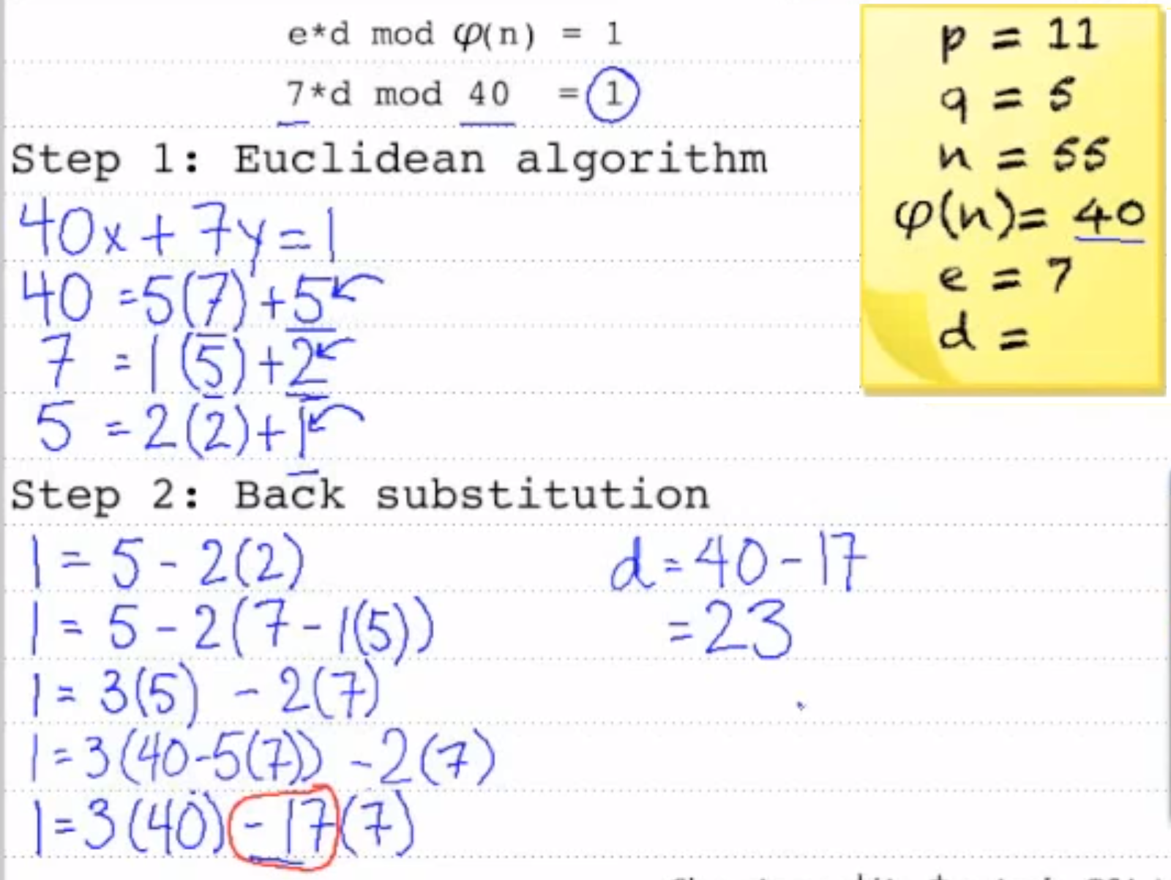
Another example
http://igotshittodo.blogspot.com/2016/05/back-substitution-feedback.html
Notes:
Another excellent example here http://mathforum.org/library/drmath/view/51623.html
https://www.wolframalpha.com/input/?i=79%5E(-1)+mod+3220&wal=header

Slide 29
Attacks and Countermeasures
Brute force key search
using exhaustive search for factoring of n in order to obtain Φ(n)
Can be prevented using a sufficiently large modulus n
The current factoring record is 664 bits. Thus, it is recommended that n should have a bit length between 1024 and 3072 bits
Implementation attacks such Side-channel analysis
Exploit physical leakage of RSA implementation (e.g., power consumption, etc.)
Timing attacks on running of decryption can infer operand size based on time taken
Notes:
RSA is typically exposed to these analytical and Implementation attacks
Potential Attacks:
1. - infeasible given size of numbers
2. Timing attacks - on running of decryption
Can Infer operand size based on time taken
 Use constant time
3. Mathematical attacks - based on difficulty of computing
ø(n), by factoring modulus n
4. Chosen ciphertext attacks
RSA is typically exposed to these analytical and Implementation attacks
Mathematical attacks
The best known attack is factoring of n in order to obtain Φ(n) using exhaustive search
Can be prevented using a sufficiently large modulus n
The current factoring record is 664 bits. Thus, it is recommended that n should have a bit length between 1024 and 3072 bits
Implementation attacks such Side-channel analysis
Exploit physical leakage of RSA implementation (e.g., power consumption, etc.)

Slide 30
Summary
RSA is the most widely used public-key cryptosystem
RSA is mainly used for key exchange and digital signatures
RSA relies on the fact that it is hard to factorize n
Currently 1024-bit cannot be factored, but progress in factorization could bring this into reach within 10-15 years.
- Hence, RSA with a 2048 or 3076 bit key should be used for long-term security
30
Notes:
There are many different ways to encrypt with a block cipher. The public key e can be a short integer, the private key d needs to have the full length of the modulus n
A naïve implementation of RSA allows several attacks, and in practice RSA should be used together with padding

Slide 31
References
Asymmetric cryptography Wikipedia pages
https://en.wikipedia.org/wiki/Public-key_cryptography
https://en.wikipedia.org/wiki/RSA_(cryptosystem)
Greatest Common Divisor
https://www.youtube.com/watch?v=JUzYl1TYMcU
Extended Euclidean algorithm
https://www.youtube.com/watch?v=kYasb426Yjk
Extended Euclidean Algorithm and Inverse Modulo Tutorial
https://www.youtube.com/watch?v=fz1vxq5ts5I
Notes:
http://asn1-playground.oss.com/
Very good example http://mathforum.org/library/drmath/view/51623.html

Slide 32

RSA Key Generation Algorithm

Slide 33
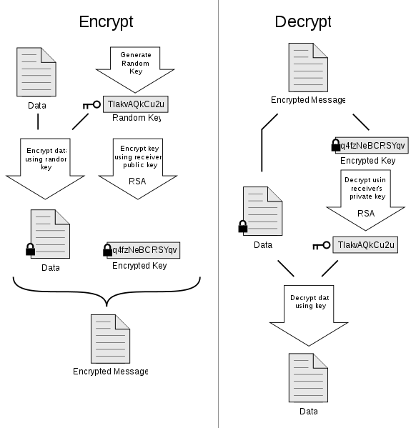
Pretty Good Privacy (PGP)

Slide 34
Key Lengths and Security Levels
Symmetric | ECC | RSA, DL | Remark
64 Bit | 128 Bit | ≈ 700 Bit | Only short term security (a few hours or days)
80 Bit | 160 Bit | ≈ 1024 Bit | Medium security (except attacks from big governmental institutions etc.)
128 Bit | 256 Bit | ≈ 3072 Bit | Long term security (without quantum computers)
The exact complexity of RSA (factoring) and DL (Index-Calculus) is difficult to estimate
The existence of quantum computers would probably be the end for ECC, RSA & DL (at least 2-3 decades away, and some people doubt that QC will ever exist)
Notes:
Remark: The long operands lead to a high computationally complexity of
public-key algorithms. This can be
a bottleneck in applications with constrained microprocessors
(e.g., mobile applications) or on the server side of networks, where
many public-key operations per time unit have to be executed.

Slide 35
Basic Protocol for Public-Key Encryption
Alice
Bob
K_{pubB}
(K_{pubB},K_{prB}) = K
m
c=e_{KpubB}(m)
c
m=d_{KprB}(c)
→ Key Distribution Problem solved *
*) but public keys need to be authenticated! More on this later....

Slide 36
Public-Key Signature Scheme
Verification Process
Signing Process
Message M
to be signed
Data
Compressor
(Hash Function)
Data
Digest
Public Key of User A
Private Key of User A
Public-Key
Signature
Generator
Message M
Reject
Check
Signature S_{a}
of user A
Signature S_{a}
Accept
Signed Message
36

Slide 37
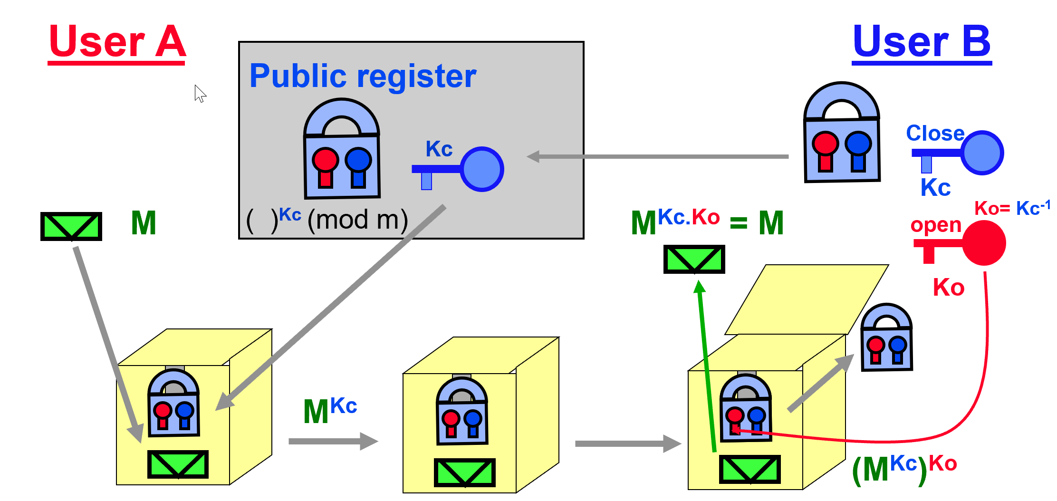
Asymmetric Cryptography: Analogy (User B gets a secured message from A)
Notes:
Two Major Schemes in Public Key Cryptography:
Diffie-Hellman Public Key exchange scheme
RSA public Key secrecy system

Slide 38
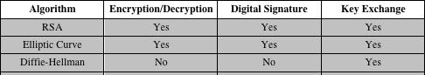
Applications for Public-Key Cryptosystems
38
Notes:
Some algorithms are suitable for all three applications, whereas others can be
used only for one or two of these applications. Table 9.3 indicates the applications
supported by the algorithms discussed in this book.

